Slide 1

MALIGNANT COMMENTS CLASSIFICATION
14-04-2022
Internship-24
Presented by: Ram kumar

Slide 2
Acknowledgement
Data Science with ML
SME -Khushoo Garg
Flip Robo Technology

Slide 3
What is MALIGNANT COMMENTS CLASSIFICATION?
The proliferation of social media enables people to express their opinions widely online. However, at the same time, this has resulted in the emergence of conflict and hate, making online ironments uninviting for users. Although researchers have found that hate is a problem across multiple platforms, there is a lack of models for online hate detection.
Online hate, described as abusive language, aggression, cyberbullying, hatefulness and many others has been identified as a major threat on online social media platforms. Social media platforms are the most prominent grounds for such toxic behaviour
Our goal is to build a prototype of online hate and abuse comment classifier which can used to classify hate and offensive comments so that it can be controlled and restricted from spreading hatred and cyberbullying.

Slide 4
Visualization of MALIGNANT COMMENTS CLASSIFICATION

Slide 5
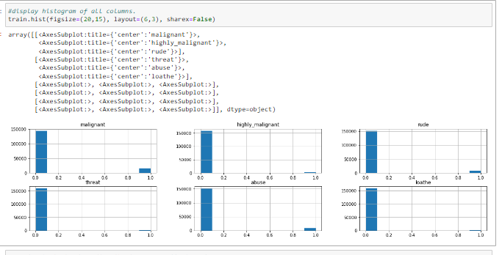
Graphs:
This histogram gives numbers of counts and showing .
.

Slide 6
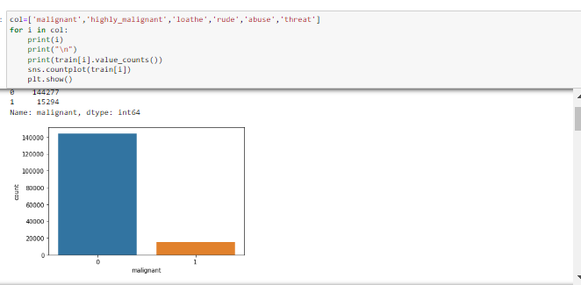
Graphs:

Slide 7
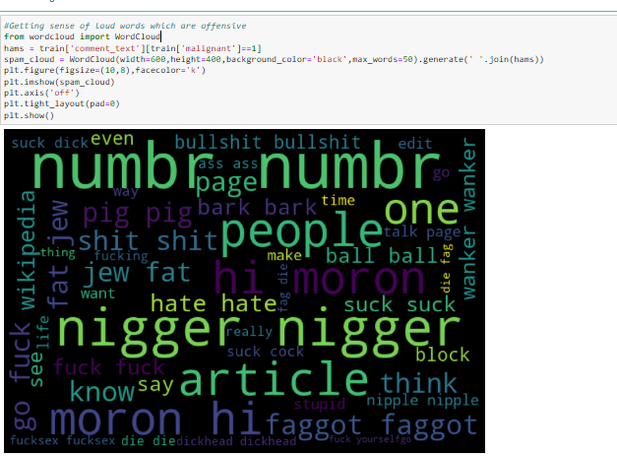
Getting sense of loud words which are offensive

Slide 8
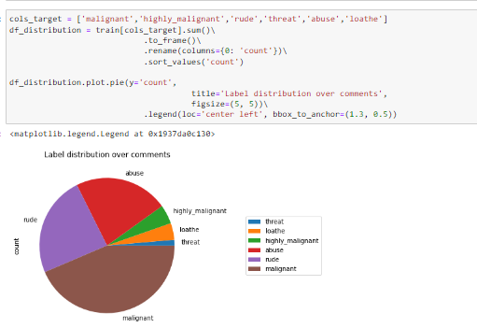
Display distribution values:

Slide 9
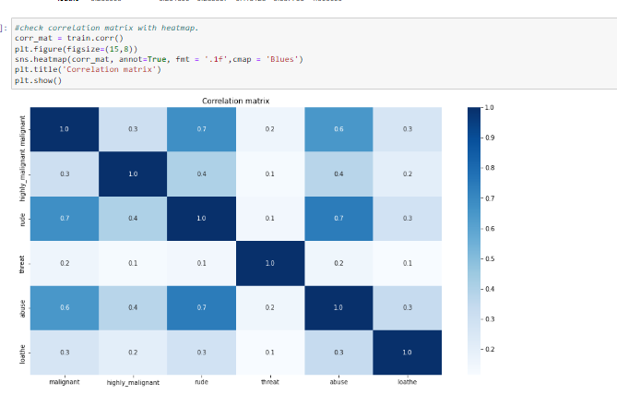
Graphs:

Slide 10
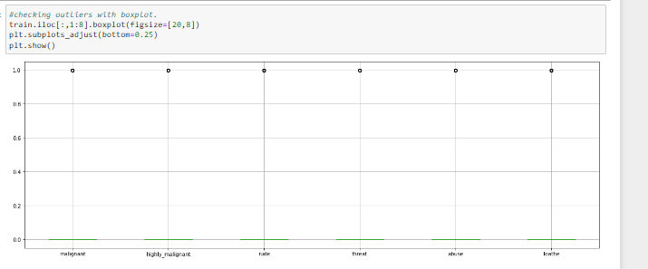
Graphs:

Slide 11
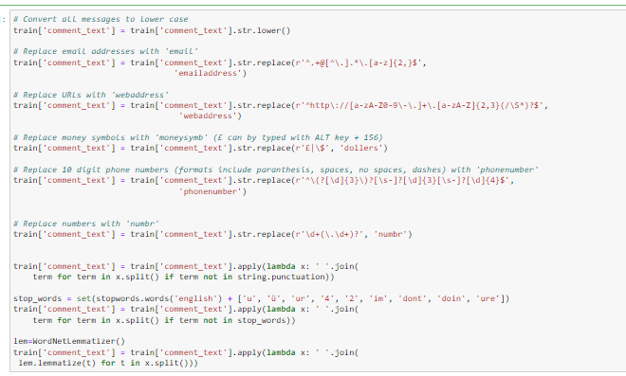
Feature engeenering

Slide 12
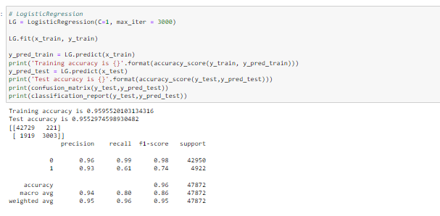
Testing of Identified Approaches (Algorithms):
.

Slide 13
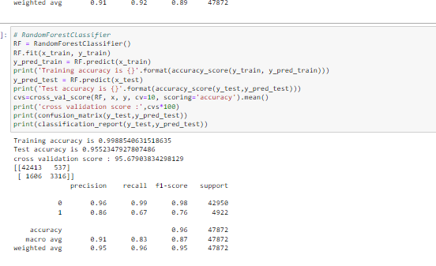
Run and Evaluate selected models

Slide 14
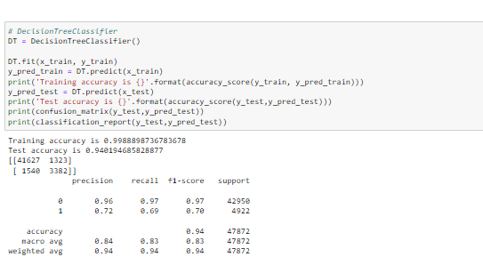
Run and Evaluate selected models

Slide 15
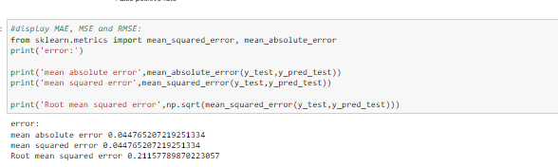
Creating RMSE:

Slide 16
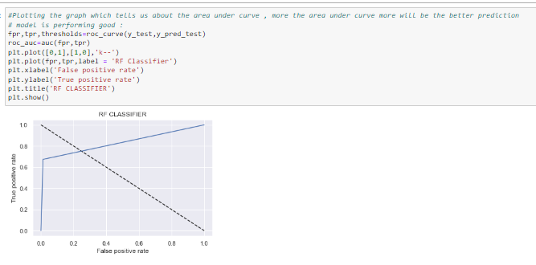
Interpretation of the Results

Slide 17
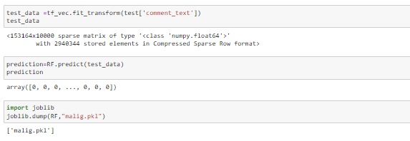
Prediction of test dataset:

Slide 18
CONCLUSION :
The proliferation of social media enables people to express their opinions widely online.
However, at the same time, this has resulted in the emergence of conflict and hate, making online environments uninviting for users.
Online hate, described as abusive language, aggression, cyberbullying, hatefulness and many others has been identified as a major threat on online social media platforms.
This can take a toll on anyone and affect them mentally leading to depression, mental illness, self-hatred and suicidal thoughts.
Internet comments are bastions of hatred and vitriol.

